Slide 1


Slide 2
JOINS
JOINS are used to retrieve data from multiple tables. It is performed whenever two or more tables are joined in a SQL statement.
INNER JOIN (or sometimes called simple join)
LEFT OUTER JOIN (or sometimes called LEFT JOIN)
RIGHT OUTER JOIN (or sometimes called RIGHT JOIN)
FULL OUTER JOIN (or sometimes called FULL JOIN)
CROSS JOIN (or sometimes called CARTESIAN JOIN)
TYPES

Slide 3
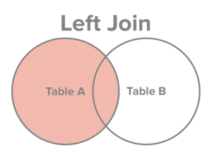
LEFT JOIN
The LEFT JOIN returns all rows from the left table, even if there are no matches in the right table.
SELECT table1.column1, table2.column2...
FROM table1
LEFT JOIN table2
ON table1.common_field = table2.common_field;
Syntax

Slide 4
LEFT JOIN
The LEFT JOIN returns all rows from the left table, even if there are no matches in the right table.
SELECT
a.order_line ,
a.product_id,
a.customer_id,
a.sales,
b.customer_name,
b.age
FROM sales_2015 AS a
LEFT JOIN customer_20_60 AS b
ON a.customer_id = b.customer_id
ORDER BY customer_id;
Example

